Slide 1
Process Cycle
Draft Outline
Static (wireframe equivalent) storyboard version first
Refinement Feedback
Create Assets
Editing and Ongoing Refinements
Production
Draft Outline
Title Sequence (PowerPoint Animation)
The Team (Photos and Voice-Over)
Intro (Text as well as talking head)
What it is
Tight description on who it's for and what it's for
Current alternatives (Photos first – video later)
Our objectives
Fun (Each person?)
Do something worthwhile
Get something up on the Playstore
It's on the Google PlayStore (screenshot)
Quick Application Demo
App
Site
Current Feature Set (list voice-over – later: screenshot)
Datasets we used for it list (static Slide)
Application Architecture (static slide)
Future Features & RoadMap (voice-over)
Our experience of the event (brief comments)

Slide 2
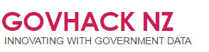
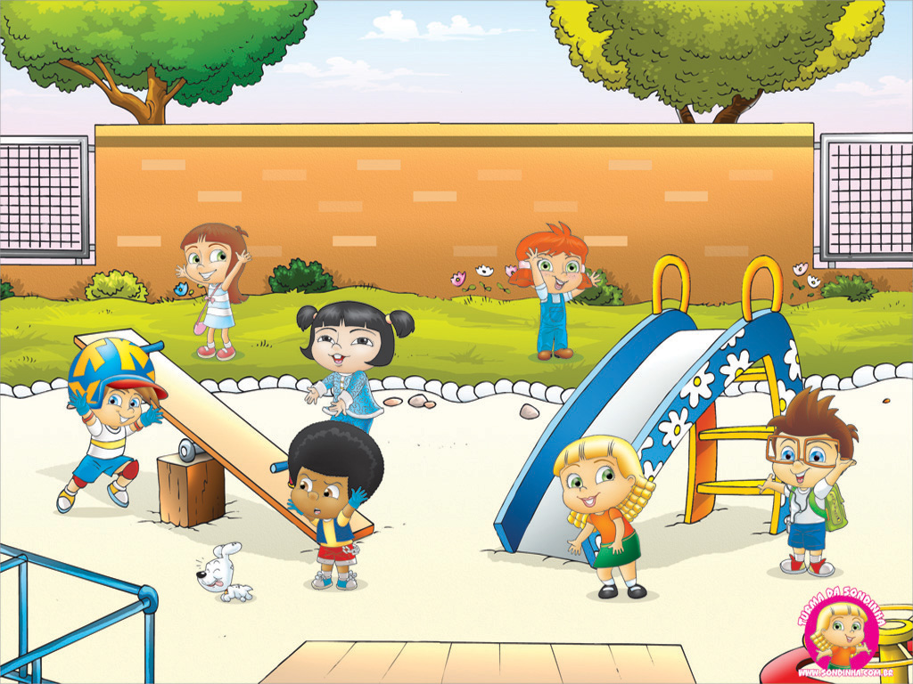

The
Kiwi Playgrounds
App & Website
Team Tumbleweed
(Auckland)

Slide 3


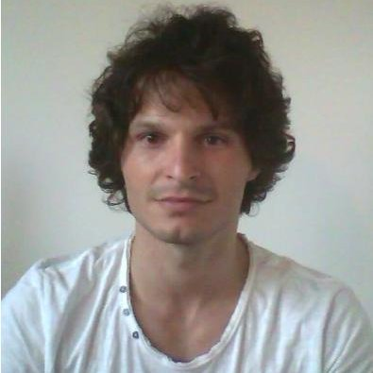


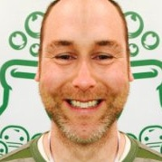
Our Team
Stefan Schlieb
John Graves
Quentin Thurier
Gary Bartlett
Fred Schmidt
Doug Hunt
Notes:
Photo (or better, video) of each person
Voice-over saying what each person brings and is contributing
Video of everyone working on their various project elements
Voice-over explaining how much fun we had and how well we worked together (e.g.
Short bursts of alignment/collaboration
Pair programming and design
People just got on with their parts

Slide 4
Intro
What it is
It’s an app that enables parents to quickly find playgrounds close to where they are or further on the basis of playground equipment, key features and user-provided ratings.
Current alternatives - from most to least helpful – include:
Family Places (App) – Nice idea. Dated (2011)
PlayGrounds in Auckland (Site) – List arranged in sequence on a page
Auckland Regional Parks (Site) – parks, not playgounds.
It’s on the Google Play Store: Kiwi Playgrounds

Slide 5
Quick Application Demo
App
Use Case Story
I want my child to learn, have fun and meet new people
It’s difficult to find playgrounds and know if I and my child will like them
Being able to find out what they have and see a photo of them – and other people’s ratings would make it so much easier.
So, all I do is… Run the app. It will centre on my current location. Wow, there are lots of playgrounds in Auckland. I can scale things in the normal way. Click on a playground; read the information; decide where I want to go; (Click the Go There icon and it will pop Google Maps and tell me how far away it is in minutes – and I can use the directions if I don’t know how to get there already.).
Or I can select the criteria that interest me and it will provide a filtered set of playgrounds that match the criteria I’ve specified.
Website

Slide 6
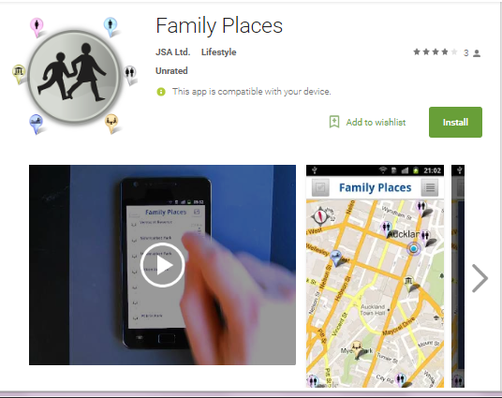
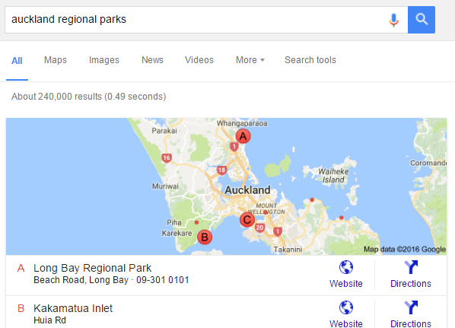
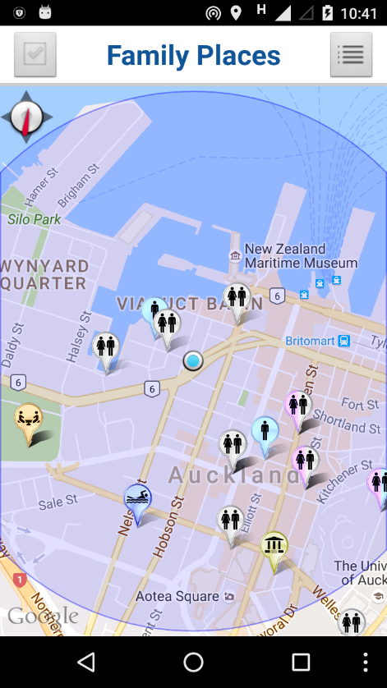
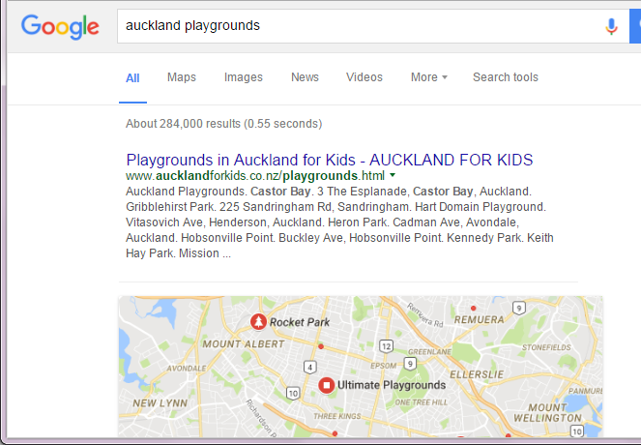
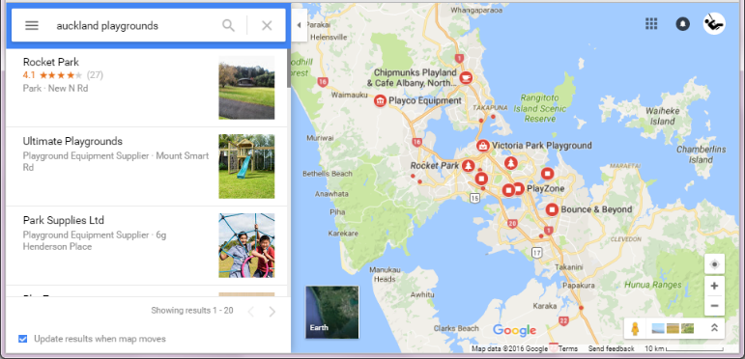
Alternatives

Slide 7
Current Feature Set

Slide 8
Datasets we used for it

Slide 9
Application Architecture

Slide 10
Future Features and RoadMap

Slide 11
Our experience of the event
Great fun
Valuable experience
Catering and venue was amazing
Thanks to Cherie, IAG and all of our sponsors (Sponsor logos?)

Slide 12









Thanks to our Sponsors!

Slide 13
